Slide 1

Handwriting Text Recognition Using a CRNN Model

Slide 2
Introduction
We are honored to present this graduation project titled ‘Handwriting Text Recognition Using a CRNN Model’.
This project focuses on leveraging deep learning—specifically, a Convolutional Recurrent Neural Network architecture—to accurately convert handwritten text images into editable digital text. Throughout this presentation, I will walk you through the motivation, methodology, system design, results, and future prospects of this work.

Slide 3
Problem Statement
Despite advancements in OCR technologies, recognizing cursive or diverse handwritten text remains a major challenge. Traditional systems like Tesseract perform poorly on unconstrained handwriting due to irregularities in slants, stroke variations, and character spacing.

Slide 4
Problem Statement
Manual transcription of handwritten documents is time-consuming and prone to human error. Our project addresses this by building a model capable of understanding complex handwriting patterns using deep learning—especially trained on the IAM dataset, which reflects real-world variability.

Slide 5
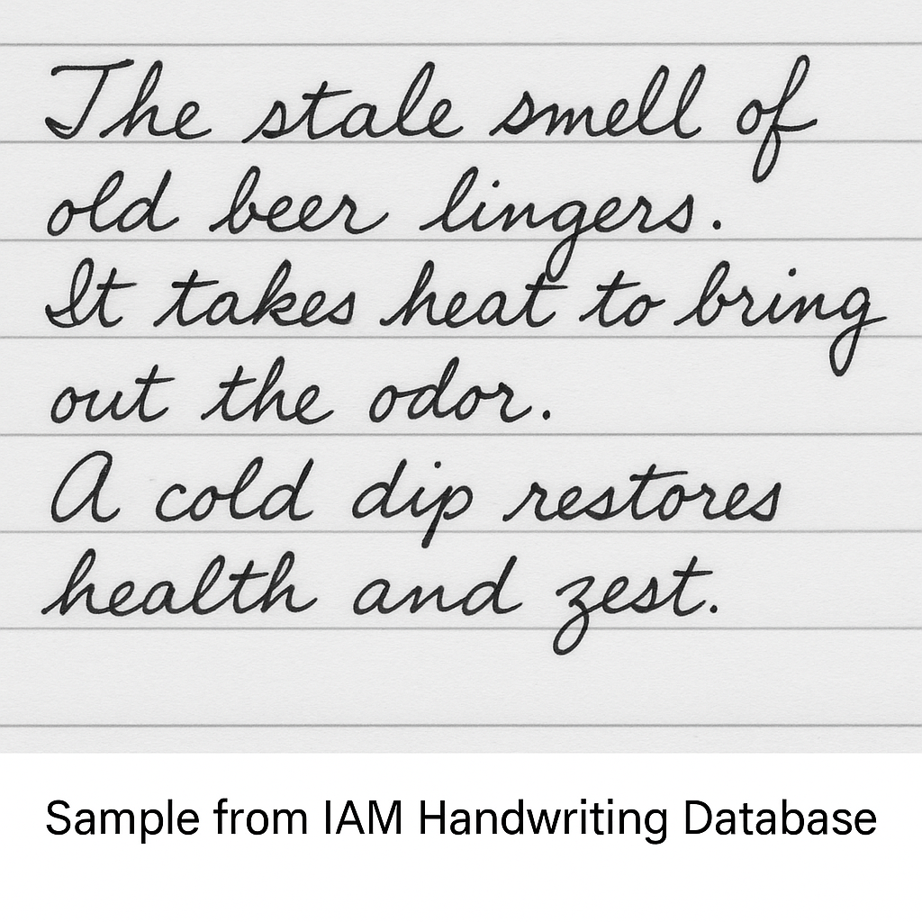

Slide 6
Literature Review
To develop a robust model, I reviewed several key papers. First, the MediaPipe framework by Lugaresi et al. introduced real-time perception pipelines, which inspired our preprocessing pipeline. Bahdanau et al.’s attention-based NMT model demonstrated the importance of sequence modeling.

Slide 7
Literature Review
Lastly, Bae and Yoon’s work on real-time pose recognition with CNNs influenced our decision to use a CRNN structure for time-dependent image data. Existing models like Tesseract OCR use rule-based logic and work poorly on free-form handwriting, which highlights the need for deep learning-based recognition.

Slide 8
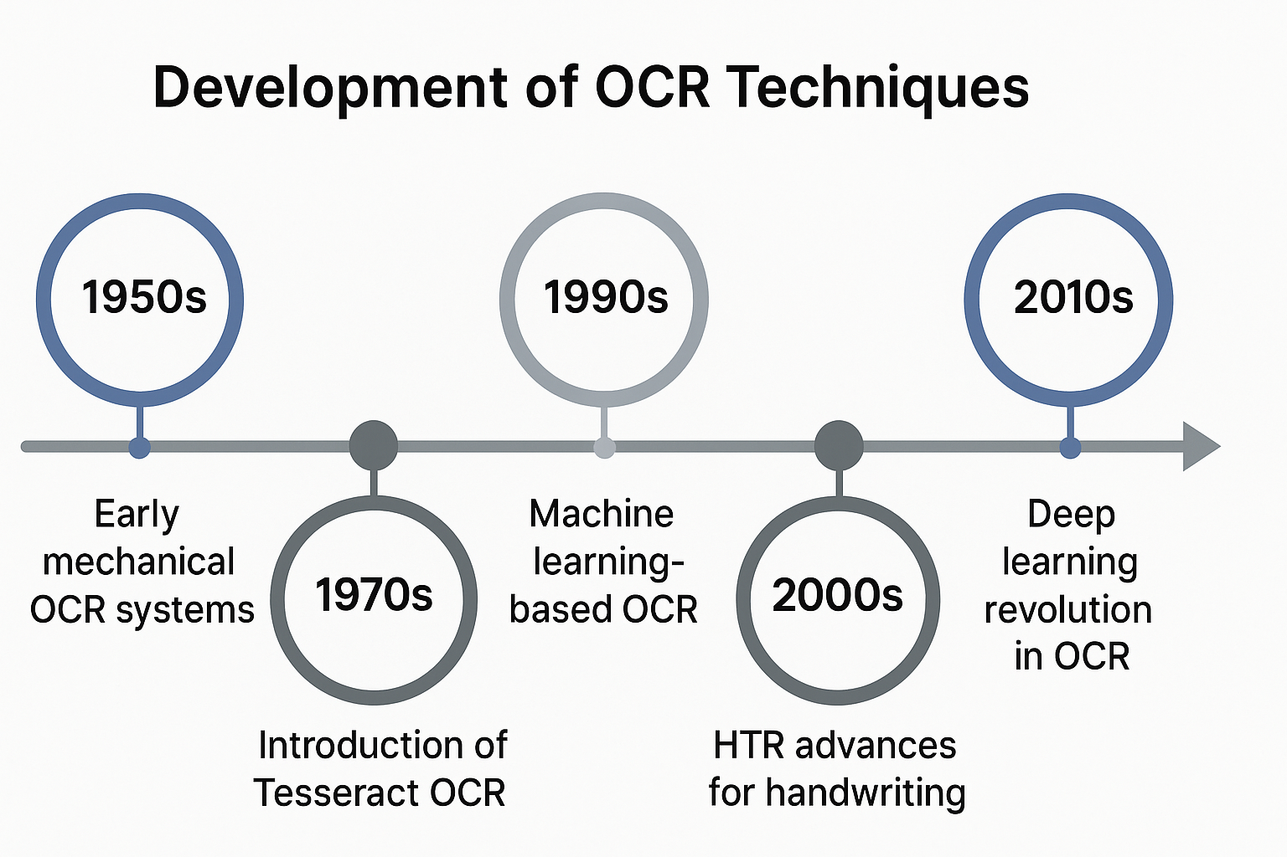
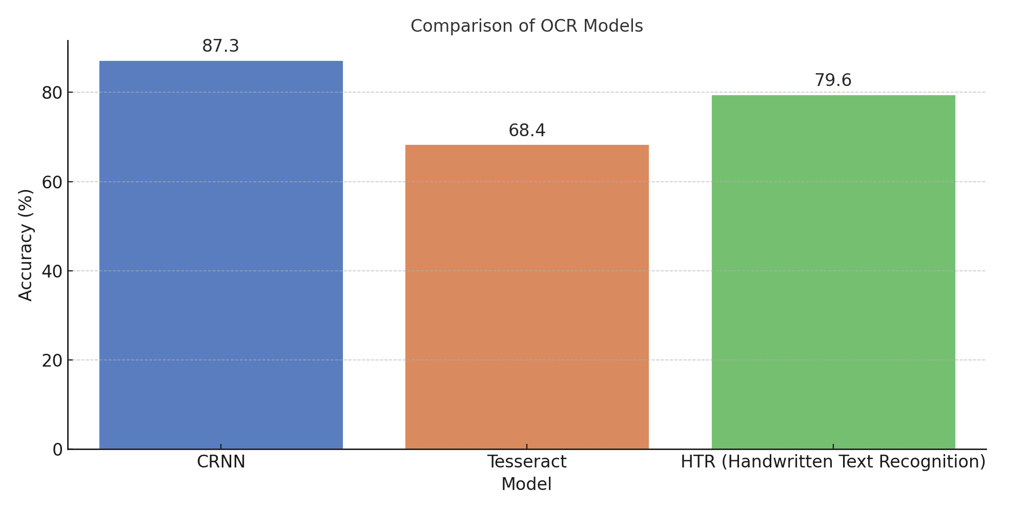

Slide 9
Objectives
Our project’s objectives include:
Building a pipeline that transforms raw scanned handwriting into recognized text.
Training a CRNN model that can generalize to unseen handwriting styles.

Slide 10
Objectives
Deploying a simple GUI to allow users to upload images and receive predicted text.
Enabling exporting results and visualizing confidence for educational and practical use. All of this was designed with usability, accuracy, and scalability in mind.

Slide 11
System Architecture
Our system is divided into the following modules:
Data Layer: Loads the IAM dataset, processes images, and encodes text labels.
Model Layer: A CRNN consisting of convolutional blocks, bidirectional LSTM layers, and a CTC loss decoder.

Slide 12
System Architecture
Inference Module: Preprocesses input images, runs the model, and decodes predictions using greedy decoding.
GUI: A Tkinter-based interface allows image upload, real-time prediction, export, and clipboard operations. All components communicate efficiently using PyTorch and TorchScript.

Slide 13
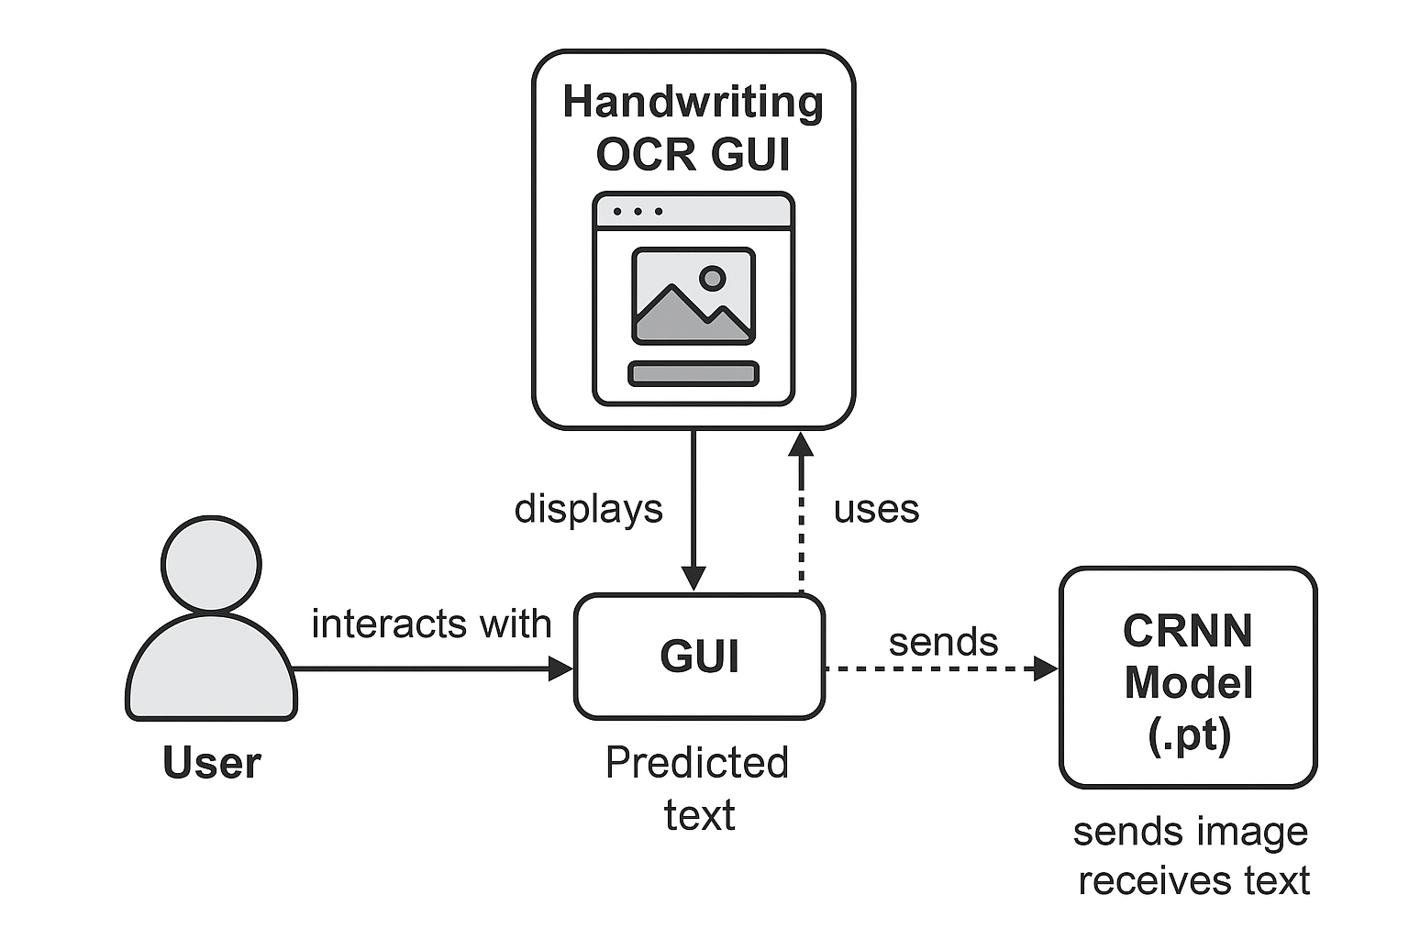
Simple
Architecture

Slide 14
Data Preparation
We used the IAM dataset, which contains segmented handwritten lines and transcriptions. Each image is converted to grayscale, resized to a fixed height while maintaining aspect ratio, and normalized. Data augmentation techniques like random rotation, perspective transformation, and color jitter were applied to improve generalization. Labels are converted into integer sequences using a vocabulary dictionary and padded to form batches.

Slide 15
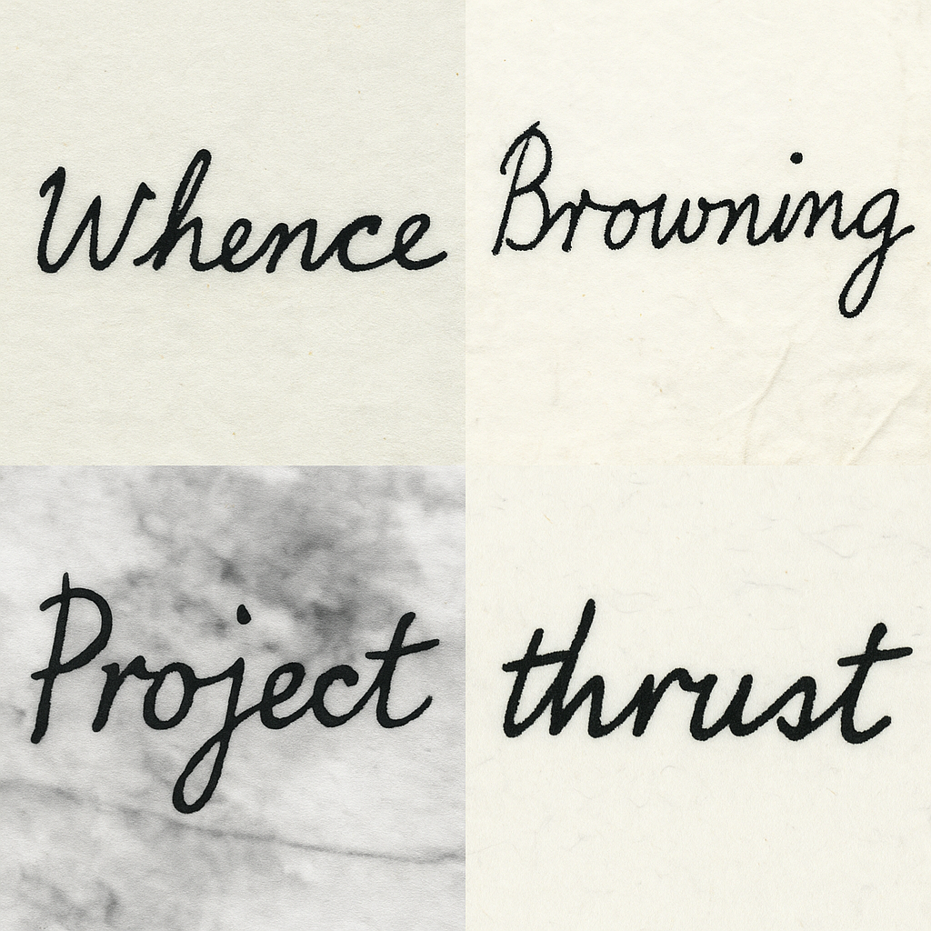
Augmented data sample

Slide 16
CRNN Model Architecture
The core of our system is the CRNN model. It begins with a convolutional feature extractor that captures spatial dependencies from the image. These feature maps are reshaped and passed to a two-layer bidirectional LSTM to model sequential dependencies in time.

Slide 17
CRNN Model Architecture
Finally, a fully connected layer projects the sequence output into character logits, followed by a CTC loss layer that allows alignment-free training. This structure ensures both spatial and temporal features are effectively utilized.

Slide 18
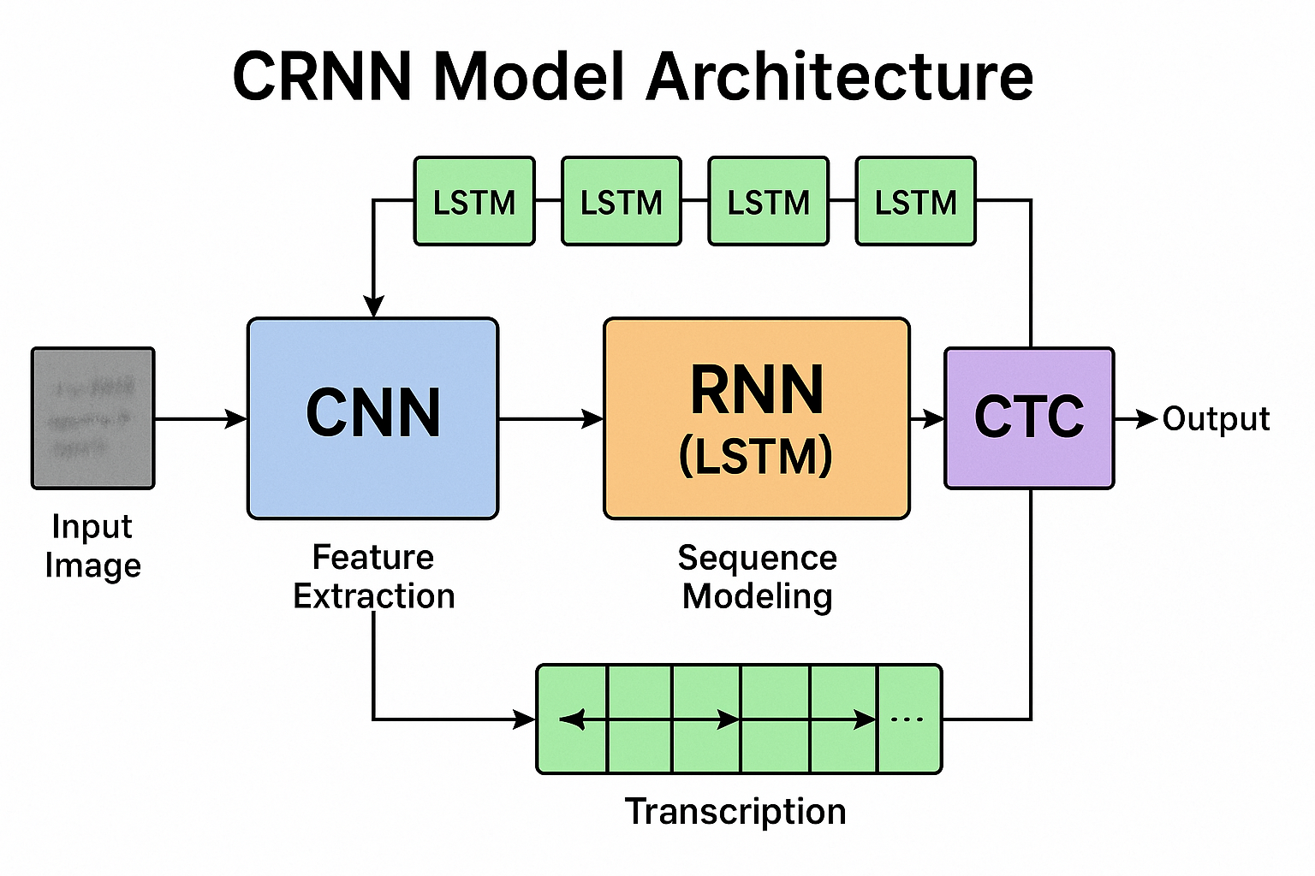

Slide 19
Training and Validation
The model was trained for 50 epochs using AdamW optimizer and a cosine annealing scheduler. Mixed-precision training with gradient scaling (AMP) was employed to accelerate convergence and reduce GPU memory consumption.

Slide 20
Training and Validation
We used CTC loss, which works well for sequence-to-sequence problems without needing alignment between inputs and outputs. The training started with a loss of around 3 and dropped to around 0.45 by epoch 50. We also saved the best model based on validation loss.

Slide 21
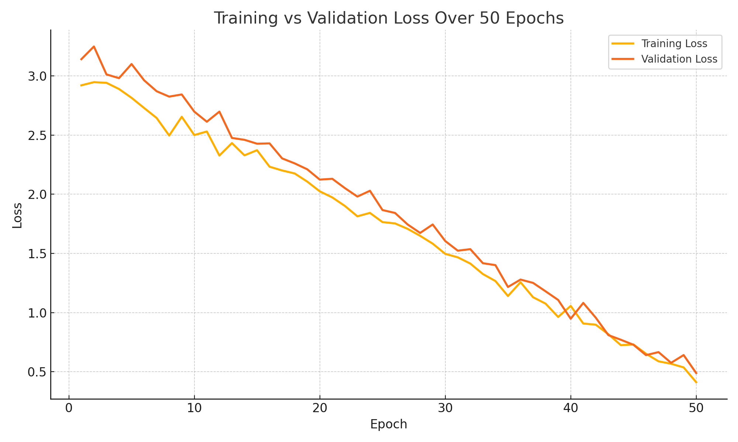

Slide 22
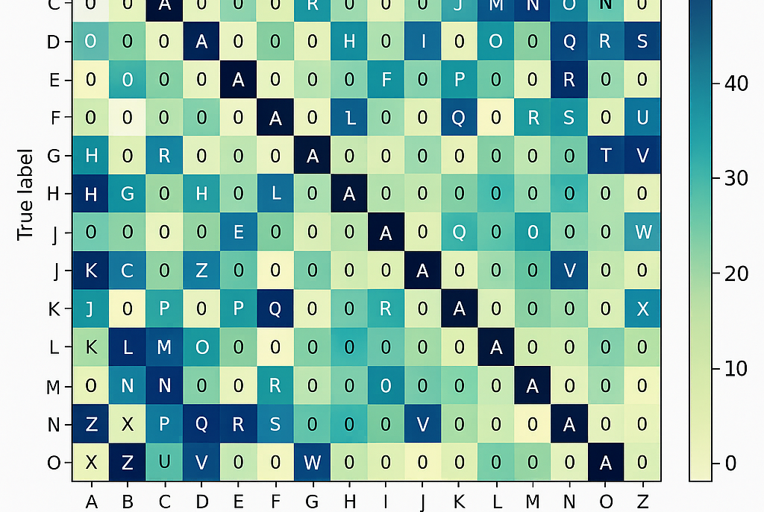
Confusion Matrix:

Slide 23
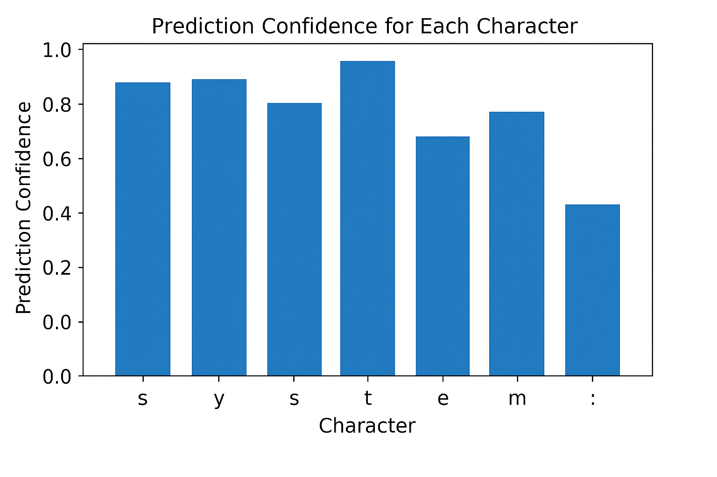

Slide 24
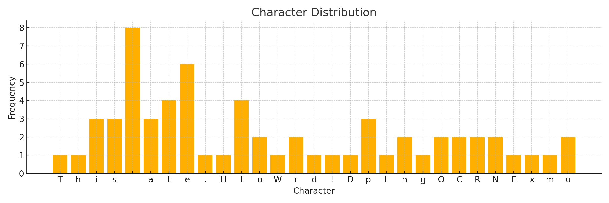

Slide 25
Evaluation and Results
We evaluated our model using greedy decoding. While accuracy is hard to measure without exact character-level labels, visual inspection showed high quality of predictions on unseen IAM samples.

Slide 26
Evaluation and Results
Additionally, we visualized prediction confidence per character, a confusion matrix for character-level predictions, and the loss curves. These metrics demonstrated the model’s stability and ability to learn robust features across varying handwriting styles.

Slide 27
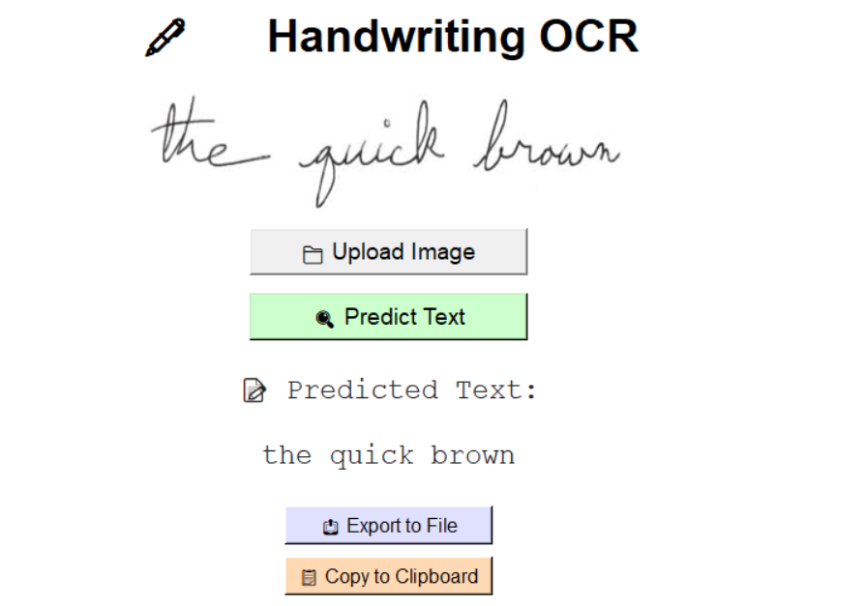

Slide 28
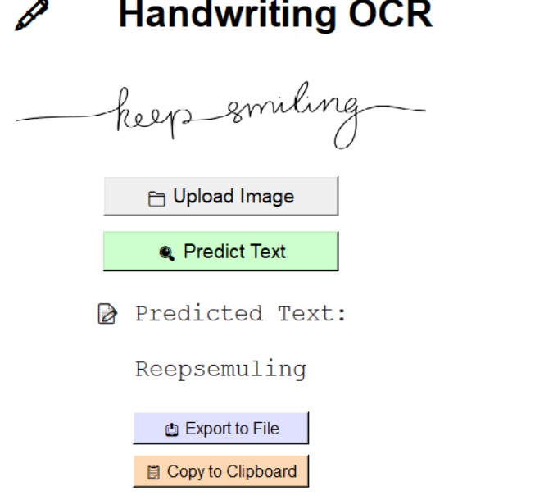

Slide 29
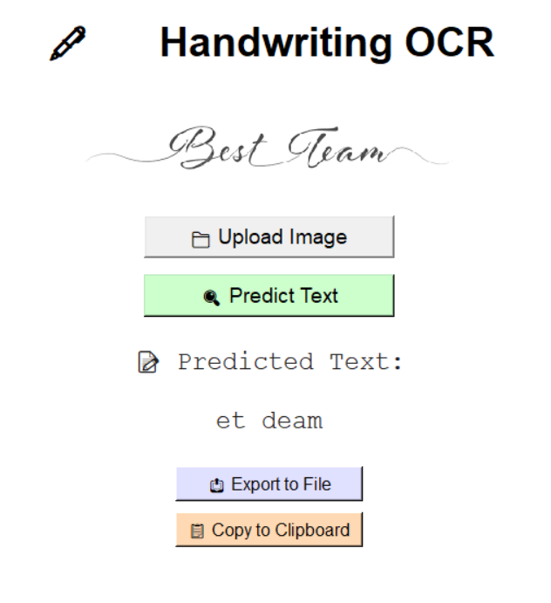

Slide 30
GUI Application
The final model was exported to TorchScript and embedded in a Tkinter-based GUI. Users can:
Upload a handwriting image.
Predict the text instantly.

Slide 31
GUI Application
Copy the result to the clipboard or export it as a .txt file.
Use the interface without requiring model retraining. The GUI features a professional background, custom styling, and feedback messages to ensure good user experience.

Slide 32
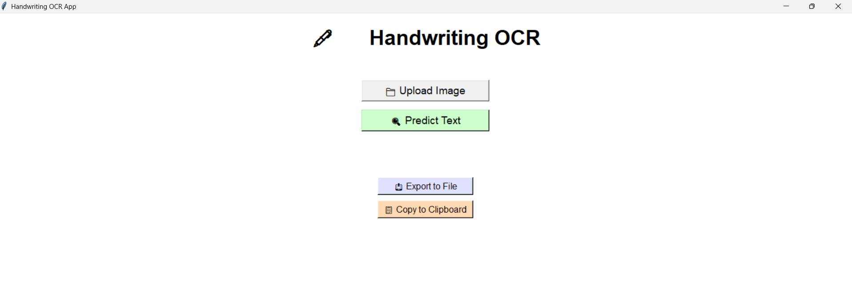
GUI

Slide 33
Testing Strategy
We applied unit testing for data preprocessing functions, integration testing for model input/output compatibility, and manual GUI testing for all interaction flows. Visual validations were done for prediction outputs. We also evaluated augmented samples to ensure the model remained robust under distortions.

Slide 34
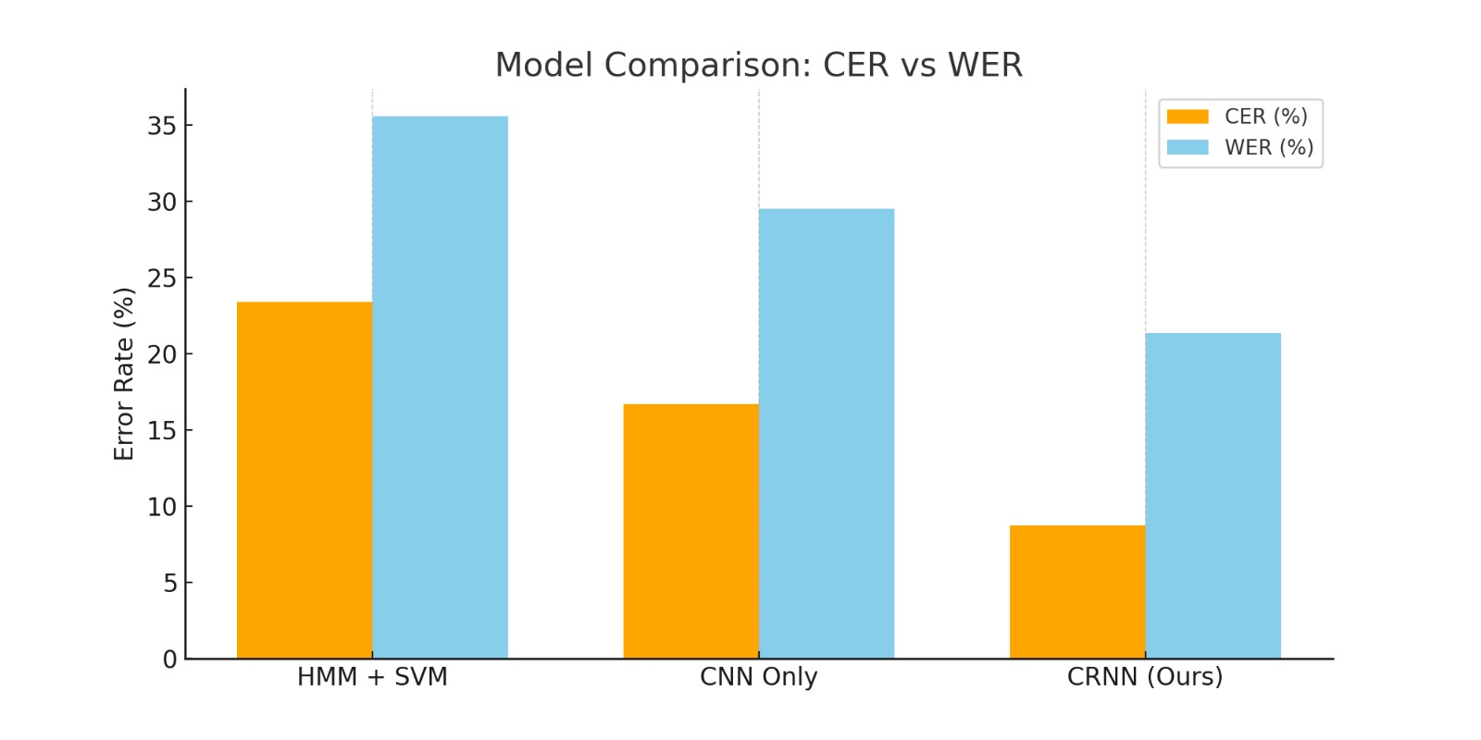

Slide 35
Limitations
While the model performs well, there are some limitations:
It uses greedy decoding, which may not be optimal for complex sequences.
The model currently supports only English characters.

Slide 36
Limitations
No real-time performance benchmarks have been done yet.
GUI is basic and not mobile-friendly. These will be addressed in the future.

Slide 37
Future Work
We will extend support to Arabic and multilingual datasets.
Add real-time inference support with camera integration.

Slide 38
Future Work
Build a cross-platform mobile app using Flutter.
Integrate search by handwriting for educational documents.
Explore attention-based decoders and language modeling to improve output coherence.

Slide 39
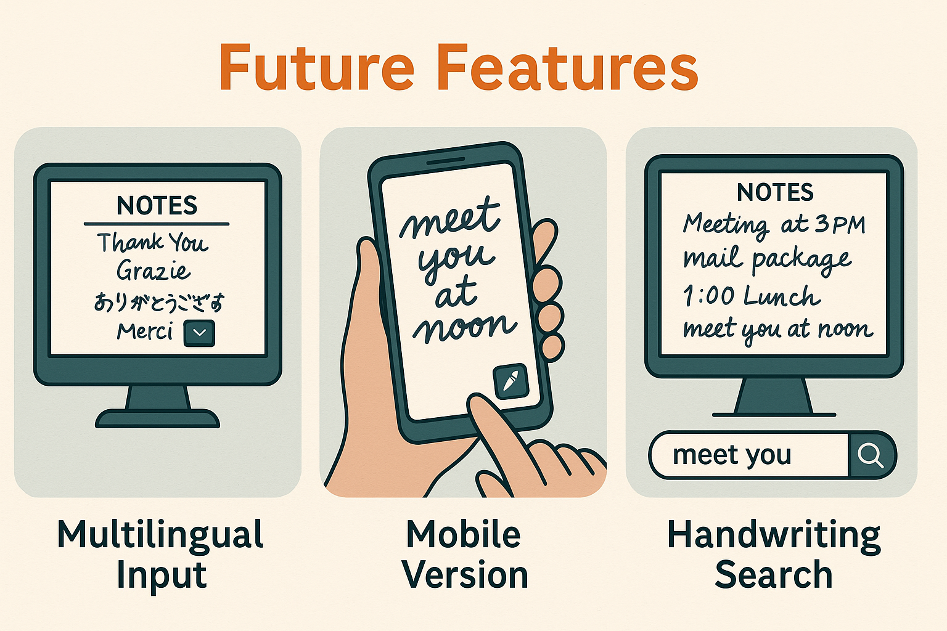

Slide 40
Thank You

